Slide 1

ETL Project – Sugar Analysis
By: Caitlan Beachey, Amaris Hassan, Cecilia Leung, Hillary Mandich, Kapil Pundhir

Slide 2
Agenda
What does ETL stand for?
Extract Data
Transform Data
Load Data to Cloud Server
Summary

Slide 3
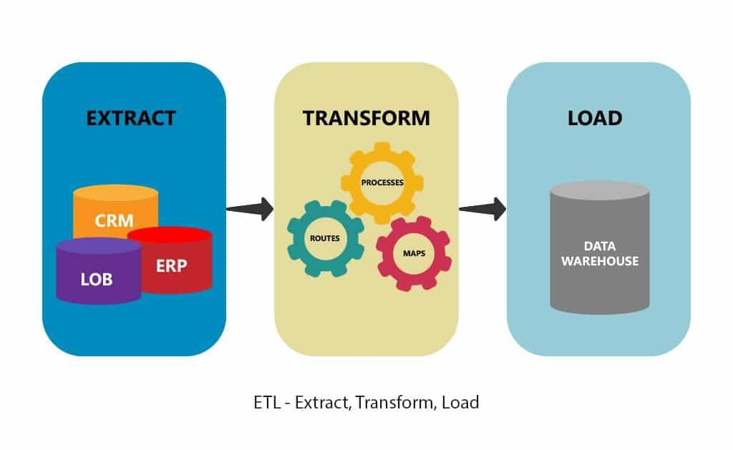
What does ETL stand for?
E

Slide 4

Extraction
The process of reading data from a database. In this stage, the data is collected, often from multiple and different types of sources.
The next few slides show the steps on how extract data.

Slide 5
Step 1: Find Relevant Data Sources
Kaggle
FAO
Wikipedia
Datasets
WHO
World-bank

Slide 6
Step 2: Decide Which Datasets to Use
Existing Datasets
1. Income by Country
2. Obesity Rates by Country
3. Sugar Intake by Country
New Datasets
1. Health Expenditures by Country
2. ISO Codes for each Country

Slide 7
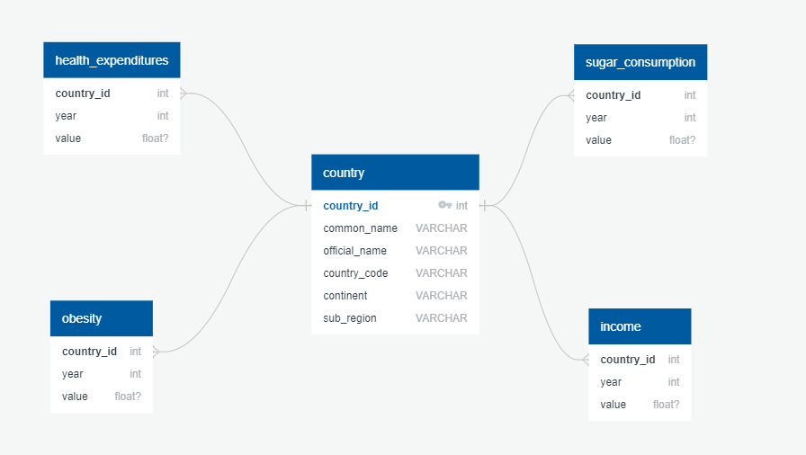
Step 3: Determine Relationship of Datasets

Slide 8
Transformation
Transform is the process of converting the extracted data from its previous form into the form it needs to be in so that it can be placed into another database. Transformation occurs by using rules or lookup tables or by combining the data with other data.
The next few slides show the steps on how transform data.

Slide 9
Transform - Me

Slide 10
Load

Slide 11
Summary

